Slide 1
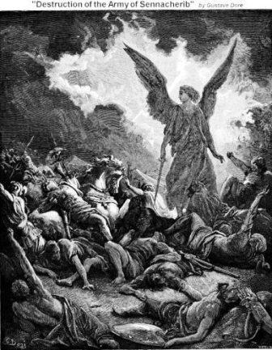
Sennacherib’s invasion of Jerusalem
701 B.C.

Slide 2
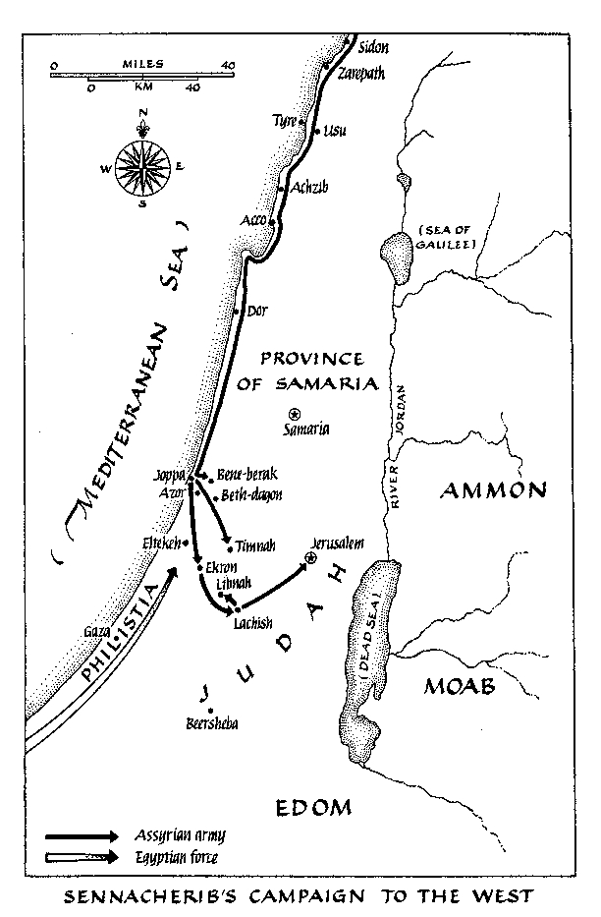

Slide 3
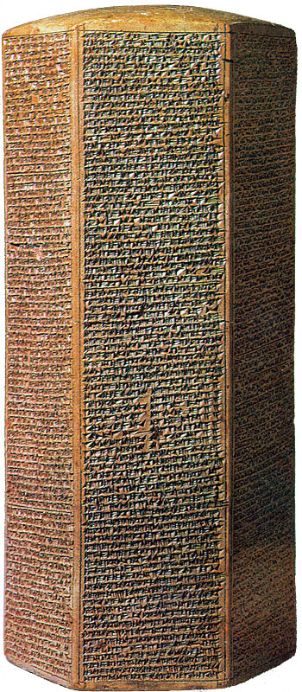
Annuls of Sennacherib’s Campaign (Sennacherib Prism)

Slide 4
Sennacherib’s Annul
I approached Ekron and slew the governors and nobles 9who had rebelled, and 10hung their bodies on stakes around the city….
18As for Hezekiah the Judahite, 19who did not submit to my yoke: forty-six of his strong, walled cities, as well as 20the small towns in their area, 21which were without number, by levelling with battering-rams 22and by bringing up seige-engines, and by attacking and storming on foot, 23by mines, tunnels, and breeches, I besieged and took them. 24200,150 people, great and small, male and female, 25horses, mules, asses, camels, 26cattle and sheep without number, I brought away from them 27and counted as spoil. (Hezekiah) himself, like a caged bird 28I shut up in Jerusalem, his royal city.

Slide 5
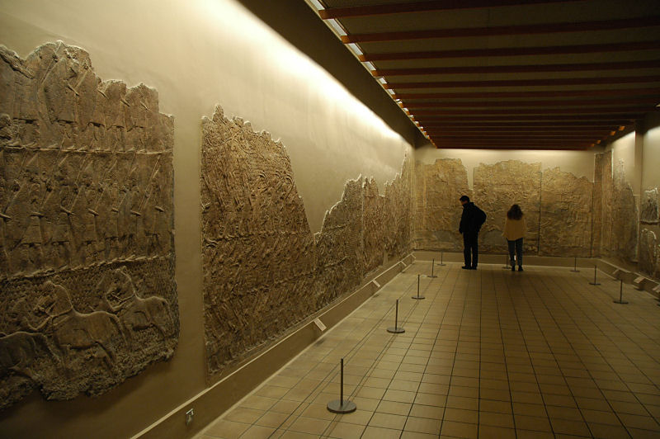

Slide 6
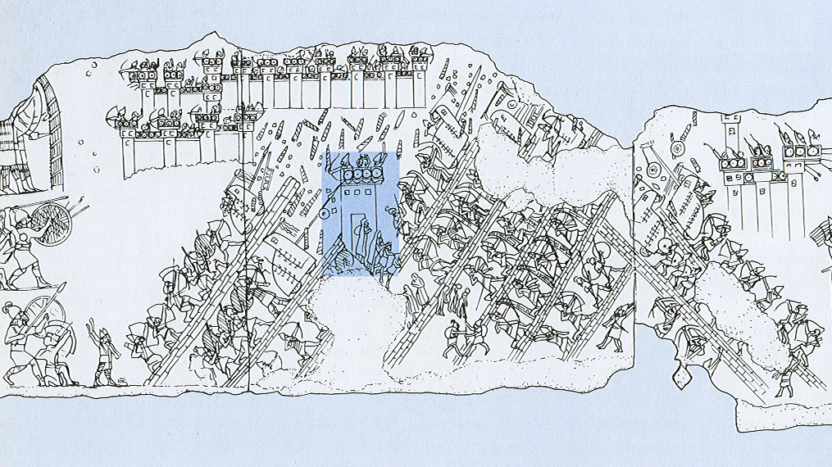

Slide 8
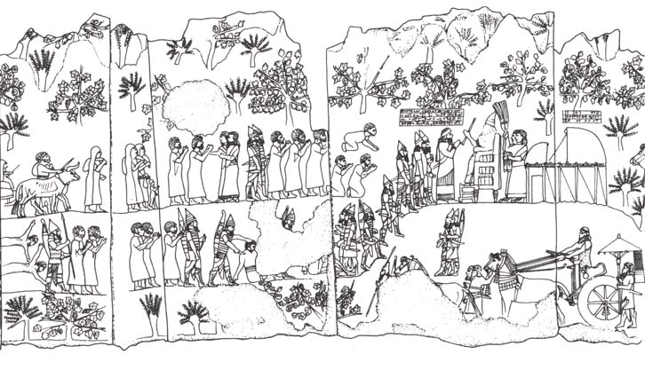
Siege of Lachish (Isa. 36:2; 37:8)

Slide 9
Sennacherib’s Annul (con’t)
²⁹I threw up earthworks against him— ³⁰the one coming out of the city-gate, I turned back to his misery. ³¹His cities, which I had despoiled, I cut off from his land…
for Hezekiah, ³⁸the terrifying splendor of my majesty overcame him, and ³⁹the Arabs and his mercenary troops which he had brought in to strengthen ⁴⁰Jerusalem, his royal city, ⁴¹deserted him. In addition to the thirty talents of gold and ⁴²eight hundred talents of silver, gems, antimony, ⁴³jewels, large carnelians, ivory-inlaid couches, ⁴⁴ivory-inlaid chairs, elephant hides, elephant tusks, ⁴⁵ebony, boxwood, all kinds of valuable treasures, ⁴⁶as well as his daughters, his harem, his male and female ⁴⁷musicians, which he had brought after me ⁴⁸to Nineveh, my royal city. To pay tribute ⁴⁹and to accept servitude, he dispatched his messengers.
THE END

Slide 10
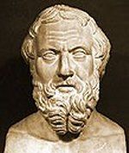
Herodotus' Account
141. After this, Sanacharib king of the Arabians and of the Assyrians marched a great host against Egypt….and encamped in Pelusion, for by this way the invasion came: and not one of the warrior class followed him, but shop-keepers and artisans and men of the market. Then after they came, there swarmed by night upon their enemies mice of the fields, and ate up their quivers and their bows, and moreover the handles of their shields, so that on the next day they fled, and being without defence of arms great numbers fell. .”
- Herodotus, Histories, 2.141
Greek Historian, 484 – 425 B.C.

Slide 11
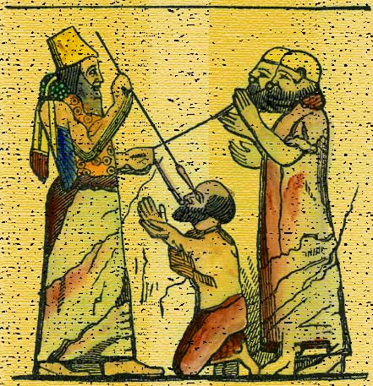
Because you have raged against Me
and your arrogance has come to my ears, I will put My hook in your nose
and My bit in your mouth,
and I will turn you back on the way
by which you came.’ (Isaiah 37:29

